Slide 1
STATE BAR of TEXAS- Aviation Law Section Continuing Legal Education Program “War, huh, yeah What is it good for? Absolutely nothing, uh” War, Lyrics by Edwin Star, (1970) Album: War and Peace Aviation Hull and Liability WAR Risk Insurance – A Primer
June 22, 2023
Presented by: Christa M. Hinckley, Counsel, Fox Rothschild LLP

Slide 2
Disclaimers
Please note that the insurance provisions, clauses and terms addressed in this presentation are solely meant to depict commonly employed insurance verbiage and concepts for the sake of discussion and are not intended to be representative of any specific insurance policy or provision issued by a given insurance carrier. The clauses and concepts included herein are simply samples that are intended to foster discussion.
Please also note that the contents of this presentation are not legal advice and should not be construed as or relied upon as legal advice. Rather, this presentation is intended to provide an aviation insurance viewpoint for attendees to consider and discuss.

Slide 3
Overview of an Insurance Policy
Aviation Hull and Liability Policies can be broken down into five major parts:*
The Declarations Page
Definitions
Insuring Agreements
Exclusions
Endorsements (Amendments and additions to the foregoing)
Generally contained within said policies, but at a different level of complexity, is “War Risk Insurance.”
*Overview provided by Glenn Vallach, United States Aircraft Insurance Group

Slide 4
Typical Exclusions
To understand “War Risk Insurance” One must start with the exclusion section(s) of the basic Aviation Hull and Liability policy.
Policy exclusions limit or exclude from the coverage provided certain types of claims, events or circumstances. These sections will tell the policyholder what is not insured, regardless of what the policy says elsewhere. Exclusions are frequently litigated.
Exclusions commonly include:
Unlawful use of Aircraft in flight with the knowledge and consent of the Insured
Use inconsistent with the purpose set forth in the Declarations
Bodily Injury or Property Damage expected or intended by Insured
Operation of Aircraft in breach of the pilot warranty

Slide 5
Typical Exclusions (cont.)
Loss or damage to any property resulting from nuclear detonation, radioactive exposure, ionizing radiations (some potential limited write-back for hazardous cargo when there is full compliance with ICAO standards)
All forms of War Risks losses for both hull and liability – but see write-back endorsements
Asbestos exposure (most policies now have extremely broad exclusions)
Contractual liability – but check endorsements; potential exceptions for certain categories of contracts

Slide 6
Typical Exclusions (cont.)
Noise, Pollution and Contamination – often some coverage for pollution caused by crash, fire, explosion or collision of aircraft, via exception to exclusion
Y2K/Date Recognition
Injury to an employee that is covered by workers’ compensation, unemployment compensation, disability benefits (No double coverage!)
Property Damage covered by premises insurance – again, no double coverage

Slide 7
Typical Exclusions (cont.)
Liability exclusions for damage to scheduled aircraft (no double coverage) and Property Damage to property owned, rented, controlled, etc. by Insured
Aircraft Physical Damage/Hull exclusions for tires, consequential loss or damage (loss of use, diminution in value, etc.), ownership change, embezzlement
Aircraft Physical Damage/Hull exclusion for “wear and tear”, deterioration, mechanical or electrical breakdown or failure, etc.,
Collateral/resultant damage covered?
Breakdown of engine component, accessory, or part
“Antecedent negligence”
Interaction with FOD

Slide 8
War Risk Exclusions and Write-Back Endorsements

Slide 9
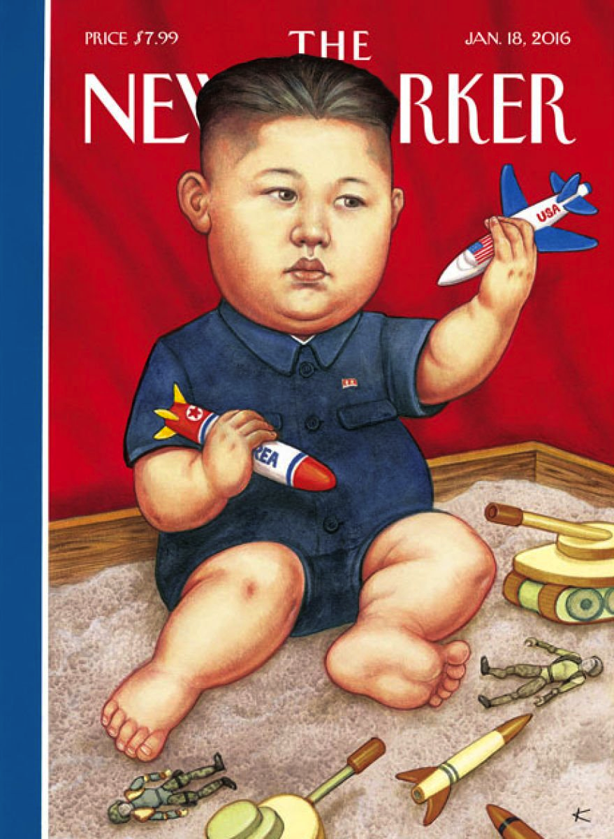

Slide 10
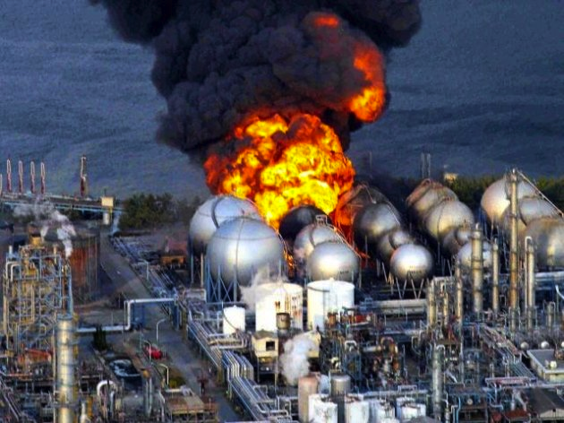
(Fukushima nuclear disaster on March 11, 2011)

Slide 11
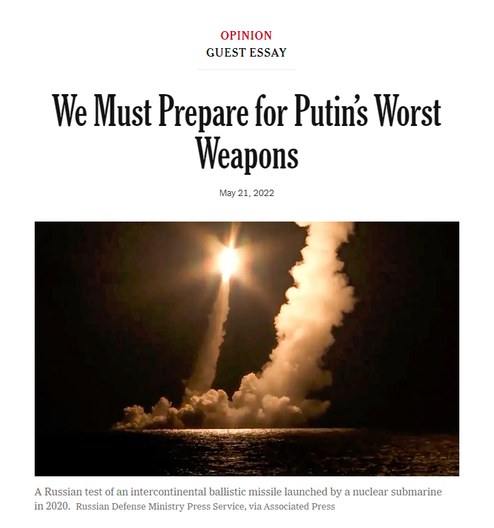
Published by the New York Times
“The West should imagine how to respond to a nuclear threat in Ukraine”
Written by Mitt Romney (@MittRomney), a senator from Utah who was the Republican nominee for president in 2012
“Russia’s foreign minister and its ambassador to the United States have both signaled that Russia’s debacle in Ukraine could lead to a nuclear strike. By claiming that Russia is readying its weapons, by warning of a “serious” risk of nuclear escalation and by declaring “there are few rules left,” they purposefully rattled the ultimate saber. Vladimir Putin himself has noted that he has weapons his opponents do not and that he will “use them, if needed.” Even the C.I.A. director, William Burns, has warned of the possibility that Mr. Putin could use a tactical nuclear weapon, even if there is no “practical evidence” right now to suggest it is imminent. Nevertheless, we should be prepared; the former secretary of state Henry Kissinger has argued that we should give the threat consideration…"

Slide 12
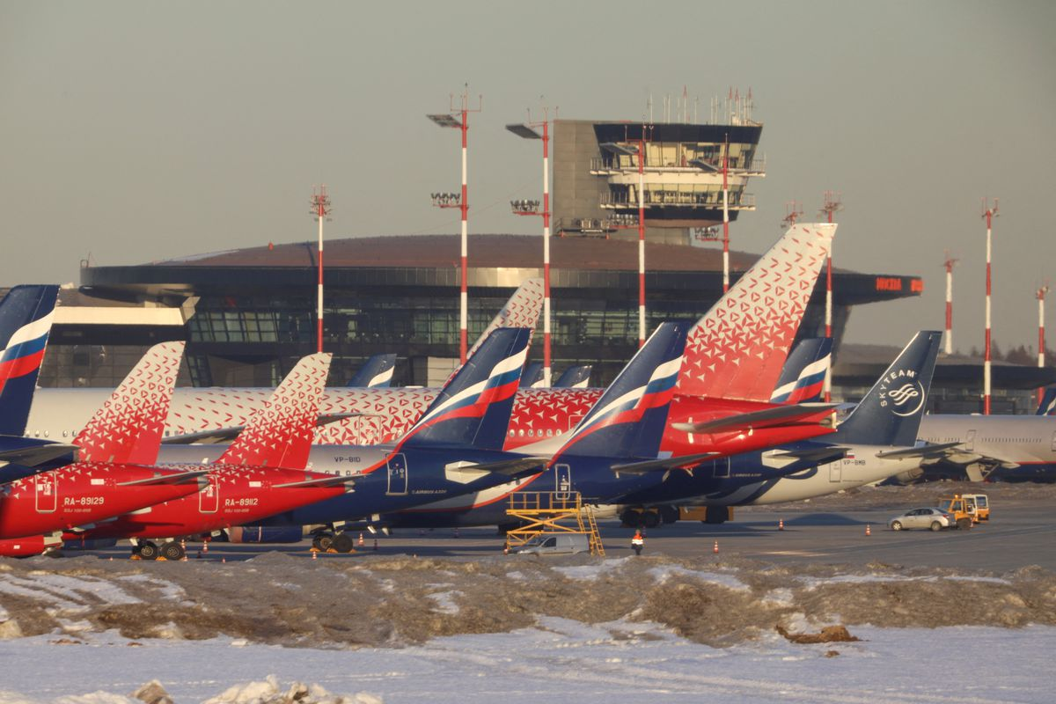
(Published by Reuters March 31, 2022)

Slide 13
War Risk Exclusions and Write-Back Endorsements
Typical Policy Construct:
All “War Risks” are excluded.
Some then are “written back” or insured through endorsement.
But, some then are excluded again.
Somewhat “tortured” construction.
What is a War Risk? What is excluded? War Risks are defined as claims (hull, liability) caused by:
War
Invasion
Acts of Foreign Enemies
Hostilities (whether war is declared or not)

Slide 14
War Risk Exclusions and Write-Back Endorsements
What is a War Risk? What is excluded? Claims (hull, liability) caused by:
Civil War
Rebellion
Revolution
Insurrection
Martial Law
Military or Usurped Power
Attempts at Usurpation
Any hostile: detonation of any device employing atomic or nuclear fission or fusion … any radioactive contamination and electromagnetic pulse resulting from such detonation; or use of radioactive contamination or matter

Slide 15
War Risk Exclusions and Write-Back Endorsements (cont.)
What is a War Risk? What is excluded? Claims (hull, liability) caused by:
Strikes, Riots, Civil Commotions or Labor Disturbances
Any act of any person(s) for political or terrorist purposes
Any malicious act or act of sabotage
Confiscation, nationalization, seizure, restraint, detention, appropriation, requisition for title or use by or under the order of any governmental (civil, military or de facto) or public or local authority
Hijacking or any unlawful seizure or wrongful exercise of control of the aircraft or crew in flight (or made by persons on board the aircraft)
Any loss due to the above risks while the aircraft is outside of the control of the insured

Slide 16
War Risk Exclusions and Write-Back Endorsements (cont.)
Most of these risks are “written back” by endorsements.
What is ALWAYS excluded from a hull loss, however, is the following:
Hostile detonation of any device employing atomic or nuclear fission or fusion … any radioactive contamination and electromagnetic pulse resulting from such detonation; or hostile use of radioactive contamination or matter
Any loss to an aircraft as a result of a detonation of any weapon of war employing atomic or nuclear fission and/or fusion or other like reaction or radioactive force or matter whether hostile or otherwise (exclusion in endorsement).
Any loss to an aircraft as a result of war between the “Great Powers” i.e., The United States, Great Britain, Russia, France, China

Slide 17
War Risk Exclusion and Write-Back Endorsements (cont.)
Amendment and Suspension (Hull Loss)
Insurers typically reserve the right to amend the hull war loss endorsement (premium and geographical limits) on 7 days notice.
Insurers also have the right to suspend this hull insurance on 7 days notice on:
The outbreak of “war”
Upon the hostile detonation of any device employing atomic or nuclear fission and/or fusion … whenever and wherever such detonation occurs and whether or not an aircraft insured under the policy is involved …
The hull insurance provided will automatically terminate or be suspended upon the outbreak of war between the “Great Powers” whether declared or not.

Slide 18
War Risk Exclusion and Write-Back Endorsements (cont.)
What is ALWAYS excluded from a liability loss (bodily injury and property damage):
Hostile detonation of any device employing atomic or nuclear fission and/or fusion … any radioactive contamination and electromagnetic pulse resulting from such detonation; or
Hostile use of radioactive contamination or matter (Exclusion in policy).
The insurance provided also terminates:
Upon the outbreak of war between the “Great Powers”, whether declared or not.
With respect to certain events, upon the hostile detonation of any device employing atomic or nuclear fission and/or fusion … whenever and wherever such detonation occurs and whether or not an aircraft insured under the policy is involved.
The insurers also typically have the right to review, amend and cancel the insurance provided on 7 days notice or sometimes 48 hours notice.

Slide 19
War Risk Exclusion and Write-Back Endorsements (cont.)
Some “war risk events” are written back, such as extortion, hi-jacking, sabotage, etc., but even these can be subject to limitations and other exclusions and restrictions as set forth in the endorsements.
Most policies give insurers the right to review premiums and geographic terms on 7 days notice for any reason and in some circumstances on 48 hours notice.
The endorsements make a distinction between claims that are excluded which arise from physical damage to the aircraft, passengers/crew and third parties and the right to automatically suspend or terminate the policy or review the coverage terms upon the happening of certain events regardless of the involvement of the insured aircraft.

Slide 20
War Risk Exclusion and Write-Back Endorsements (cont.)
OVERALL TAKEAWAY.
“War Risk” events occurring in other parts of the world which have nothing to do with your insured aircraft or your operations can affect your insurance coverage and/or raise your premiums.
“No man is an island, entire of itself. . . .” John Donne,
Devotions upon Emergent Occasions, 1624

Slide 21
Basic Structure of WAR Risk Insurance Policies

Slide 22
Pre. 9/11
Comprehensive Aviation Hull and Liability Policy
WAR, Hijacking and Other Perils Exclusion Clause excludes all listed perils from covered for both Hull and Liability
Write Back Endorsement for certain WAR Risk Liability Risk, no write back for Hull
Exclusions and cancellation policies, other terms and conditions
Hull WAR Risk Policy stand alone policy
Additional terms and exclusions and cancellation provisions
←
50/50 clause
→
← Write back endorsement was for full policy limits for passengers and on ground

Slide 23
Post. 9/11
Comprehensive Aviation Hull and Liability Policy
WAR, Hijacking and Other Perils Exclusion Clause excludes all listed perils from covered for both Hull and Liability
Write Back Endorsement for certain WAR Risk Liability Risk, no write back for Hull
Exclusions and cancellation policies, other terms and conditions
Hull WAR Risk Policy stand alone policy
Additional terms and exclusions and cancellation provisions
← Write back endorsement is for full policy limits for passengers, on the ground injuries capped, excess coverage must be purchased
←
50/50 clause
→

Slide 24
Conclusion/Questions Christa M. Hinckley, Counsel, Fox Rothschild LLP phone: 214-906-6268 email: chinckley@foxrothschild.com bio: https://www.foxrothschild.com/christa-hinckley 214-906-6268

